Slide 1
LCD Display

Slide 2
Outline
SampleCode Projects to cover:
LCD (Text)
LCD_Keypad
LCD_Bmp
LCD_Bmp_Keypad
LCD_Graph_2D
LCD_Graph_PingPong
2

Slide 3
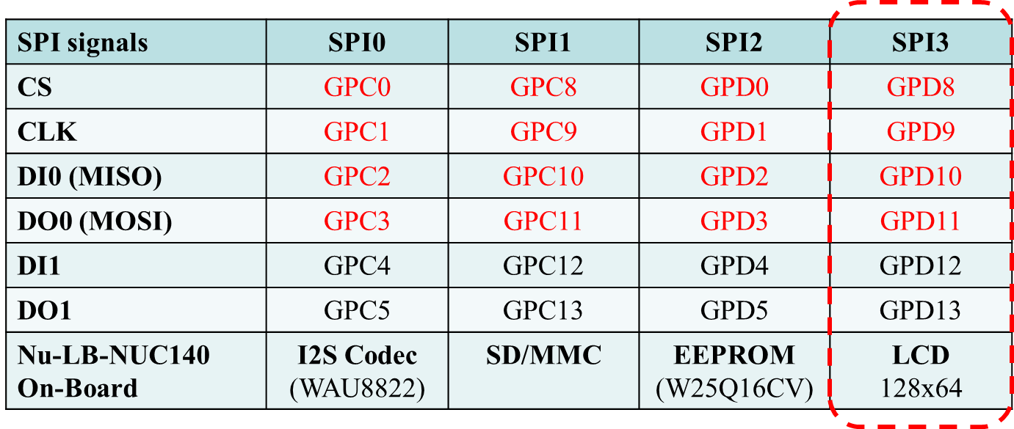
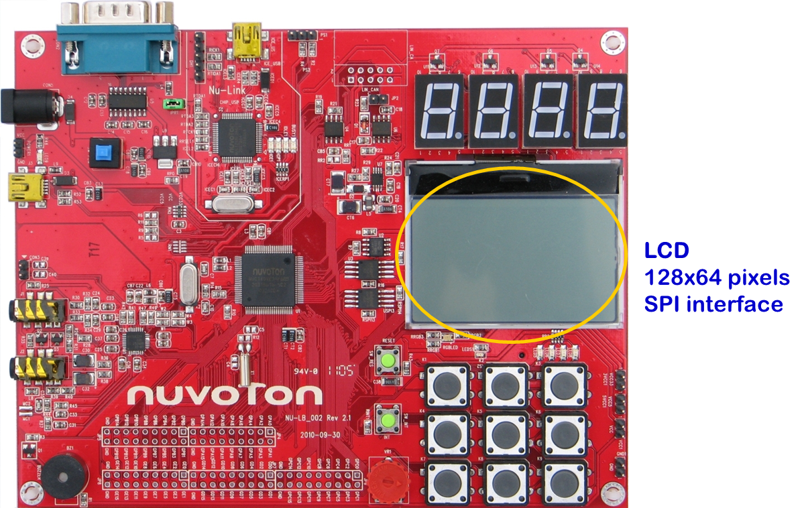
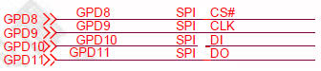
Pins to drive LCD
GPD8-GPD11 to control LCD
3

Slide 4
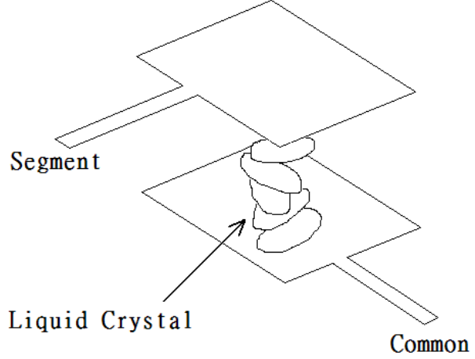
LCD Display Introduction
種類
文字型：已經有內建文字圖形（通常只有英文字母大小寫、阿拉伯數字、標點符號），只要輸入對應的字形碼（ASCII code），LCD便會將該字的圖形顯示於LCD.
繪圖型：用繪圖的方式將資料顯示於LCD. 必須先將要顯示文字的圖形依LCD所需的格式事先存起來，再將此資料依序填入LCD即可顯示對應圖形.
基本知識
LCD 裡面是兩片玻璃中間夾液晶， 上面有透明的導電線路(特殊材質) ，下面也有，上面的叫做 Segment ，下面的叫做 Common.
LCD 上的圖形是否被點亮是由Segment 和 Common 之間的電壓差決定.
4

Slide 5
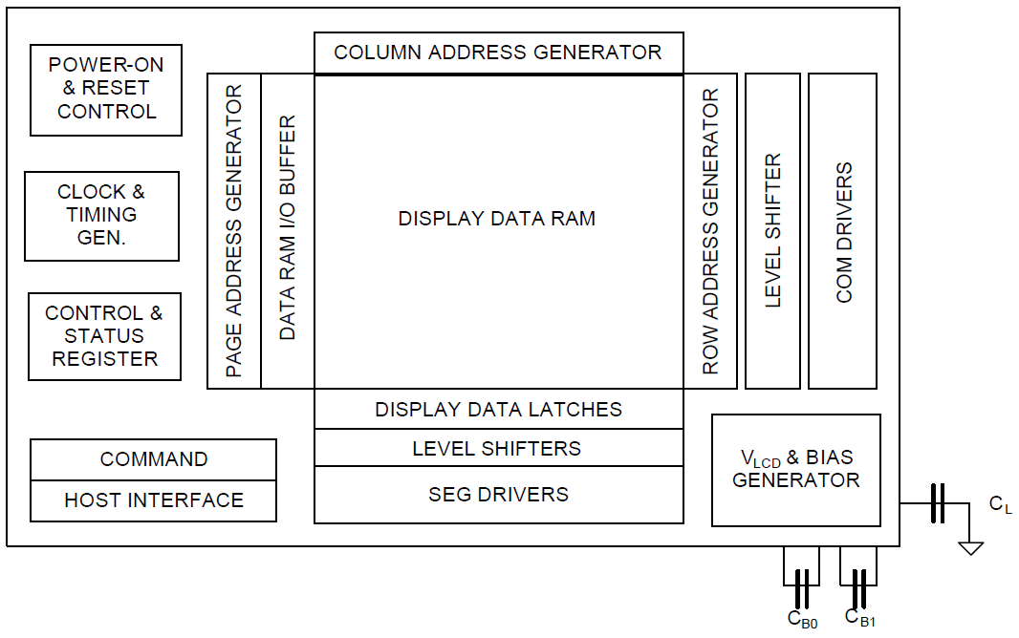
UC1601 Controller
Nu-LB-NUC140 Learning Board uses UC1601 controller to transfer data between MCU and LCD.
UC1601 block diagram:
5

Slide 6
LCD Layout: Text
(X,Y)_{Text}
LCD可以顯示4列，每列16字元
Page 0
……………………….
(0,0)
(15,0)
Page 1
Page 2
Page 3
Page 4
Page 5
Page 6
……………………….
(0,3)
(15,3)
Page 7
6

Slide 7
LCD Layout: Bitmap
(X,Y)_{Bitmap}
LCD可以顯示 128 x 64 = 8192 pixels
(0,0)
(127,0)
……………………….
……………………….
………………………………...
(0,63)
(127,63)
7

Slide 8
LCD Function Calls (LCD.h)
#define LCD_Xmax 128
#define LCD_Ymax 64
#define FG_COLOR 0xFFFF
#define BG_COLOR 0x0000
init_LCD(); → initialize LCD display
clear_LCD(); → clean up LCD display
printC(x, y, ascii_code); → print a character using font8x16 on LCD at location (x,y)
printC_5x7(x, y, ascii_code); → print a character using font 5x7 on LCD at location (x,y)
print_Line( line, text[]); → print a string (maximum = 16 charactors) on LCD (line no = 0,1,2,3)
printS(x, y, text[]); → Print a string using font 8x16 on LCD at location (x,y)
printS_5x7(x, y, text[]); → print a string using font 5x7 on LCD at location (x,y)
draw entire LCD (128x64 pixels)
Print Text
8

Slide 9
LCD Function Calls (LCD.h)
extern void draw_Bmp8x8(int16_t x, int16_t y, uint16_t fgColor, uint16_t bgColor, unsigned char bitmap[]);
extern void draw_Bmp32x8(int16_t x, int16_t y, uint16_t fgColor, uint16_t bgColor, unsigned char bitmap[]);
extern void draw_Bmp120x8(int16_t x, int16_t y, uint16_t fgColor, uint16_t bgColor, unsigned char bitmap[]);
extern void draw_Bmp8x16(int16_t x, int16_t y, uint16_t fgColor, uint16_t bgColor, unsigned char bitmap[]);
extern void draw_Bmp16x8(int16_t x, int16_t y, uint16_t fgColor, uint16_t bgColor, unsigned char bitmap[]);
extern void draw_Bmp16x16(int16_t x, int16_t y, uint16_t fgColor, uint16_t bgColor, unsigned char bitmap[]);
extern void draw_Bmp16x24(int16_t x, int16_t y, uint16_t fgColor, uint16_t bgColor, unsigned char bitmap[]);
extern void draw_Bmp16x32(int16_t x, int16_t y, uint16_t fgColor, uint16_t bgColor, unsigned char bitmap[]);
extern void draw_Bmp16x40(int16_t x, int16_t y, uint16_t fgColor, uint16_t bgColor, unsigned char bitmap[]);
extern void draw_Bmp16x48(int16_t x, int16_t y, uint16_t fgColor, uint16_t bgColor, unsigned char bitmap[]);
extern void draw_Bmp16x64(int16_t x, int16_t y, uint16_t fgColor, uint16_t bgColor, unsigned char bitmap[]);
extern void draw_Bmp32x16(int16_t x, int16_t y, uint16_t fgColor, uint16_t bgColor, unsigned char bitmap[]);
extern void draw_Bmp32x32(int16_t x, int16_t y, uint16_t fgColor, uint16_t bgColor, unsigned char bitmap[]);
extern void draw_Bmp32x48(int16_t x, int16_t y, uint16_t fgColor, uint16_t bgColor, unsigned char bitmap[]);
extern void draw_Bmp32x64(int16_t x, int16_t y, uint16_t fgColor, uint16_t bgColor, unsigned char bitmap[]);
extern void draw_Bmp64x64(int16_t x, int16_t y, uint16_t fgColor, uint16_t bgColor, unsigned char bitmap[]);
extern void draw_Pixel(int16_t x, int16_t y, uint16_t fgColor, uint16_t bgColor);
extern void draw_LCD(unsigned char *buffer);
Draw Bitmap
9

Slide 10
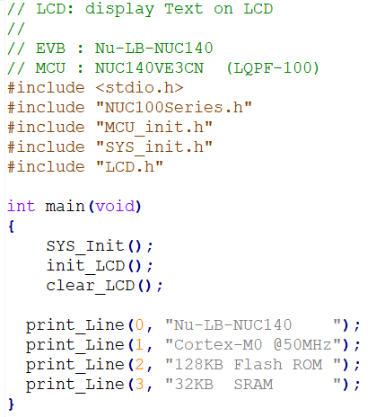
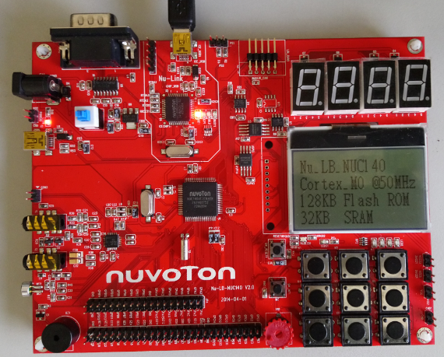
SampleCode: LCD
10

Slide 11
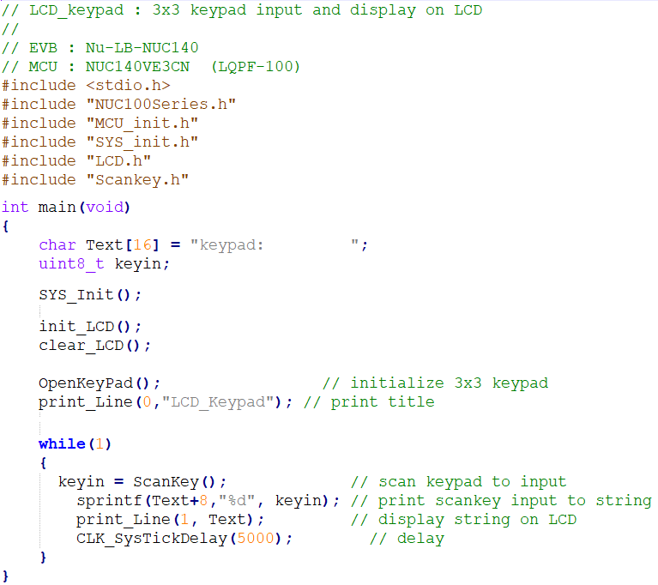
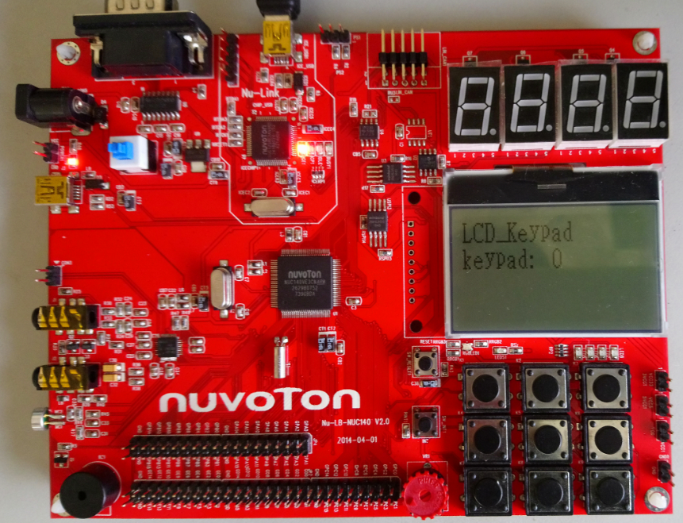
SampleCode: LCD_Keypad
11

Slide 12
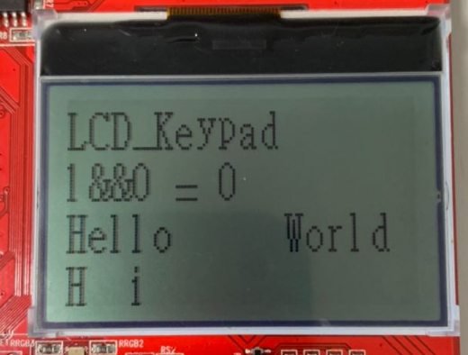
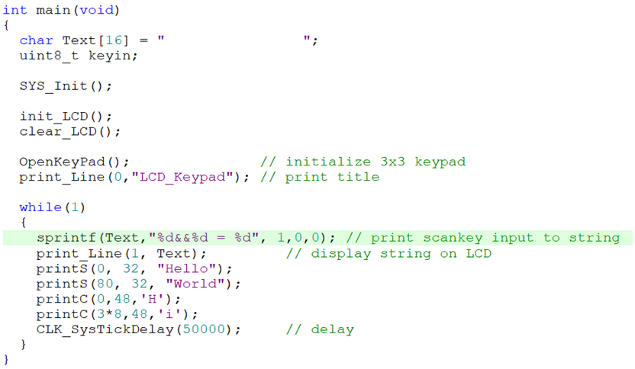
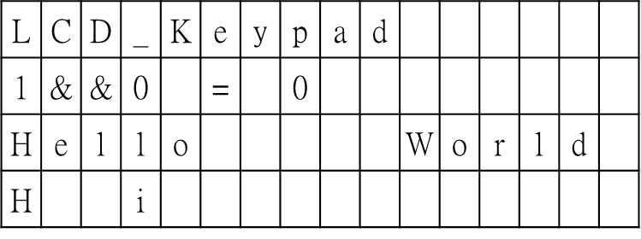
An Example
12

Slide 13
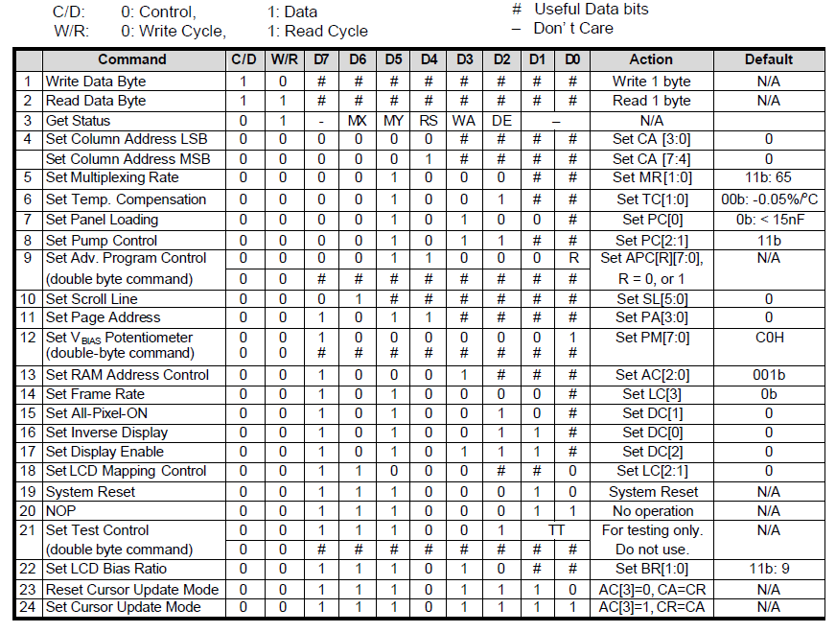
UC1601 Controller
Command Table
13

Slide 14
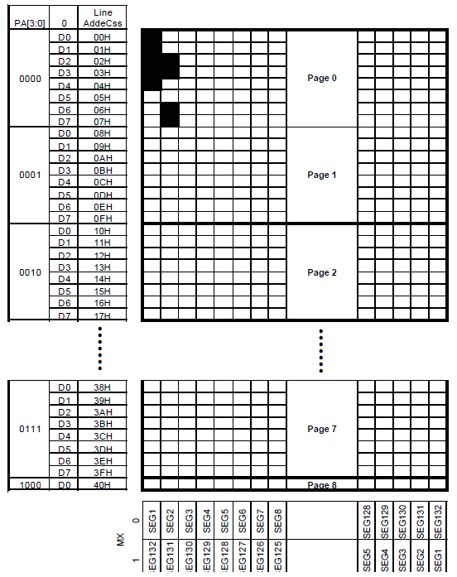
UC1601 Controller
segment
drivers
……
…………
Display Data Ram
common
drivers
Page 0, SEG 1: 00011111b
……………….
Page 0, SEG 2: 11001100b
14

Slide 15
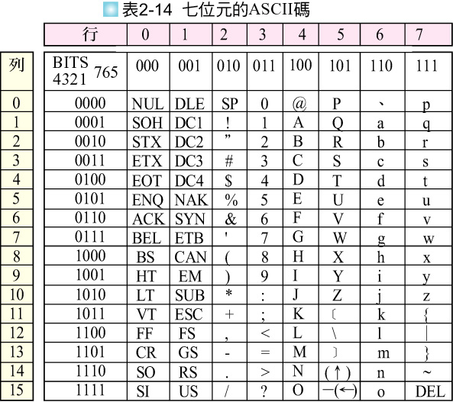
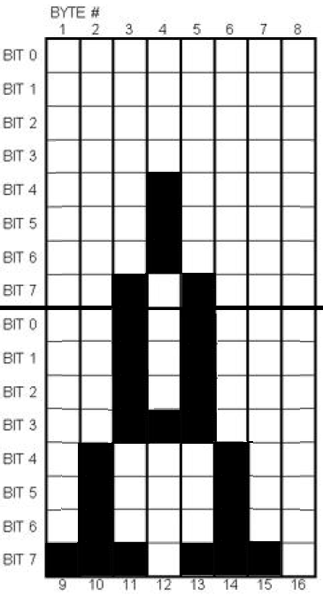
ASCII Code for Charactors
/* A */
0x00,0x00,0x80,0x70,0x80,0x00,0x00,0x00,0x80,0xF0,0x8F,0x08,0x8F,0xF0,0x80,0x00,
Page n
Page n+1
15

Slide 16
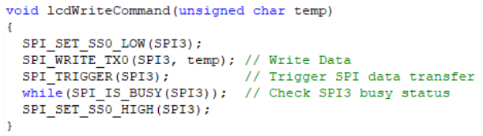
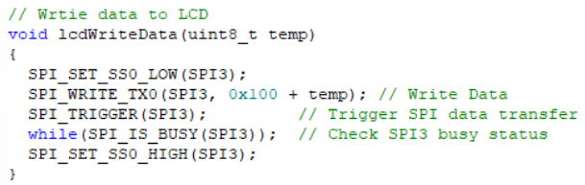
LCD.c
16

Slide 17
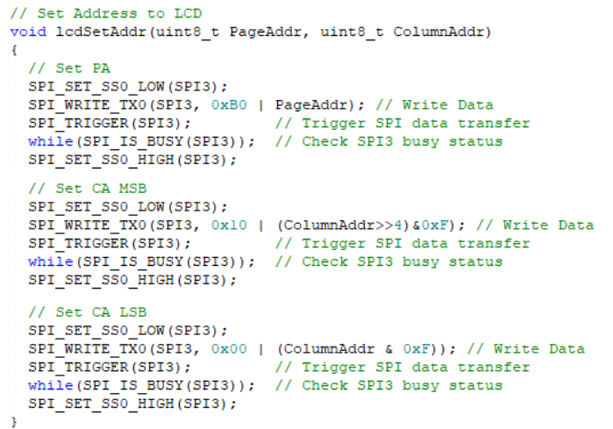
LCD.c
17

Slide 18
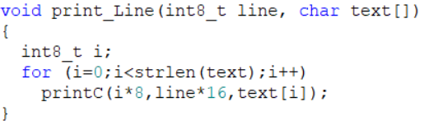
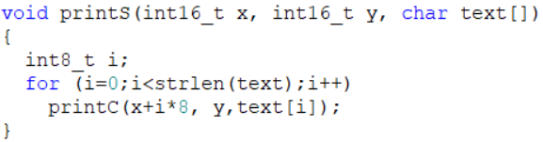
LCD.c
18

Slide 19
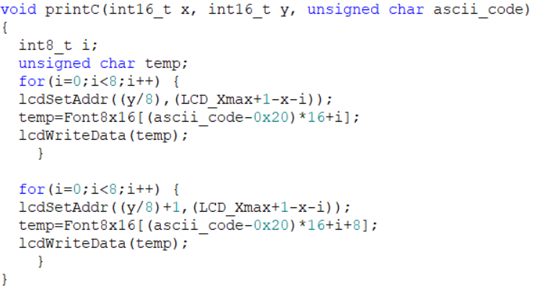
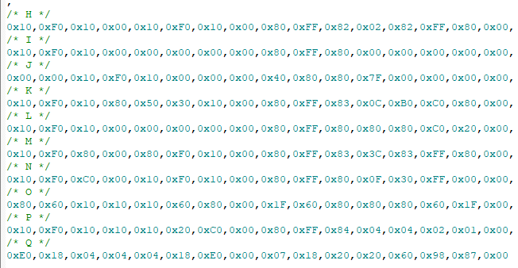
LCD.c
19

Slide 20
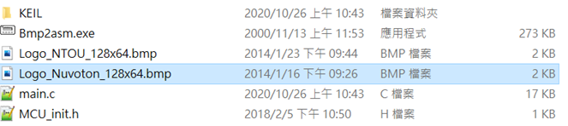
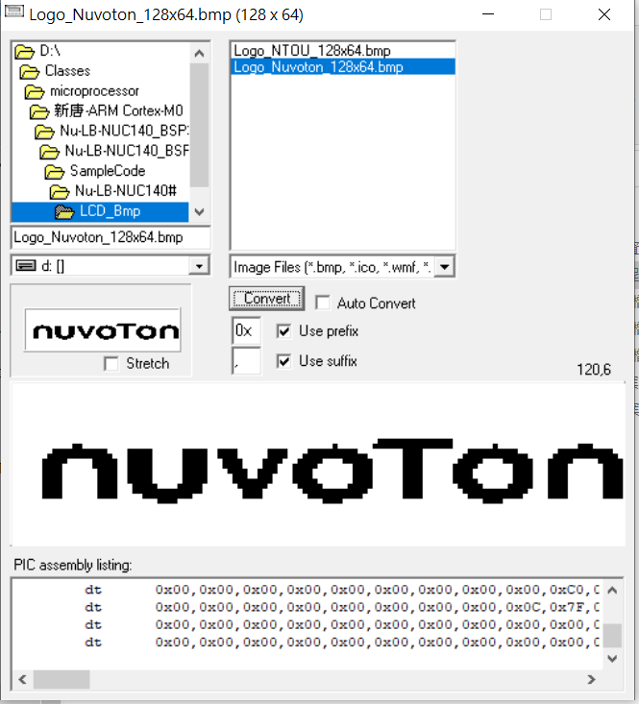
Generate Hex of Bitmap
Step 1. use 小畫家 to draw a 128x64 bitmap
Step 2. use bmp2asm to convert bitmap into
hex
Step 3. cut and paste hex of bitmap to
display buffer in your program.
20

Slide 21
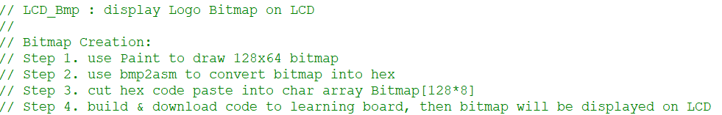
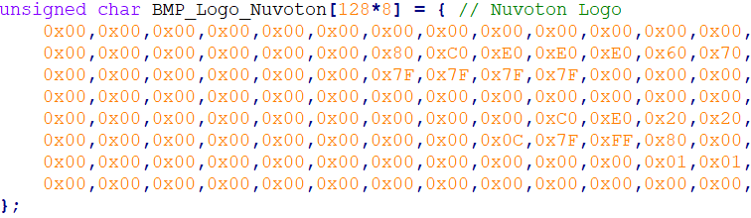
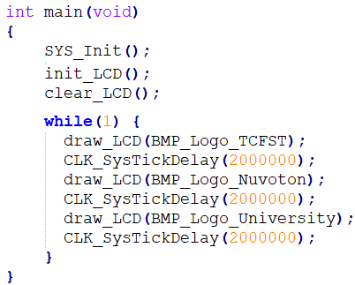
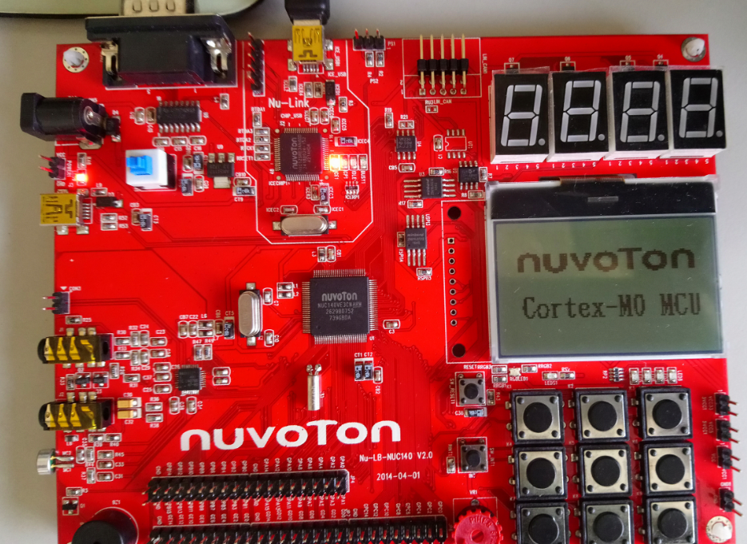
SampleCode: LCD_Bmp
………
21

Slide 22
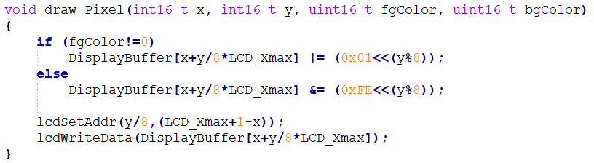
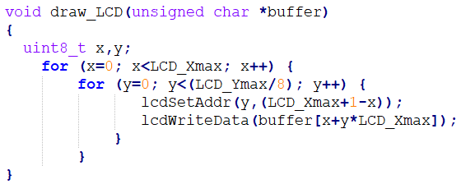
LCD.c
Set X coordinate and Y page to LCD register
Display Data write to LCD
22

Slide 23
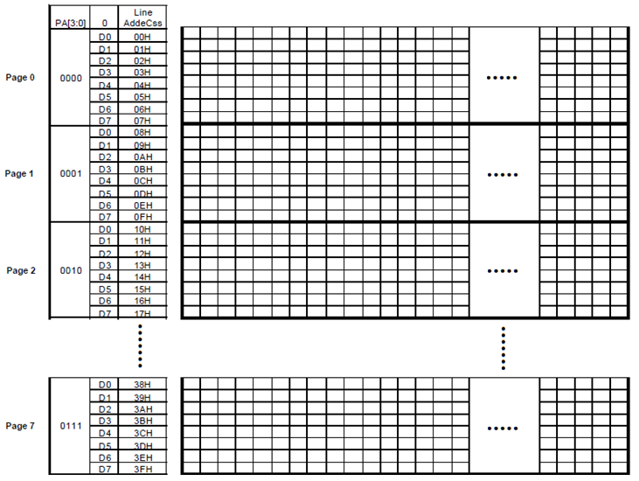
Whole Bitmap Display
x₀
x₁
x₁₂₇
a byte data at x_{i}
(draw_LCD)
pixel at (3,9)
(draw_Pixel)
23

Slide 24
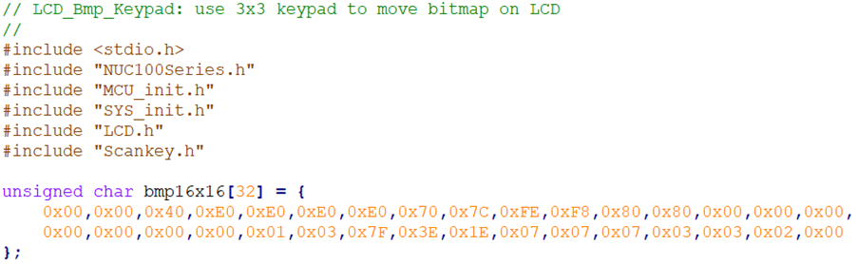
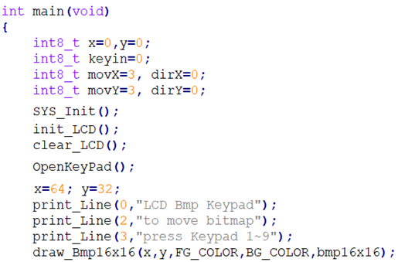
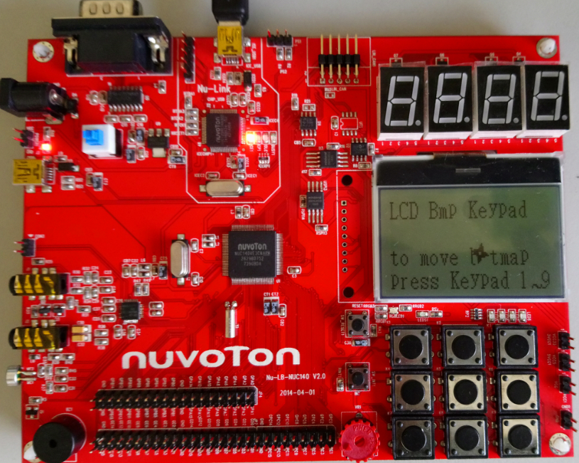
SampleCode: LCD_Bmp_Keypad
24

Slide 25
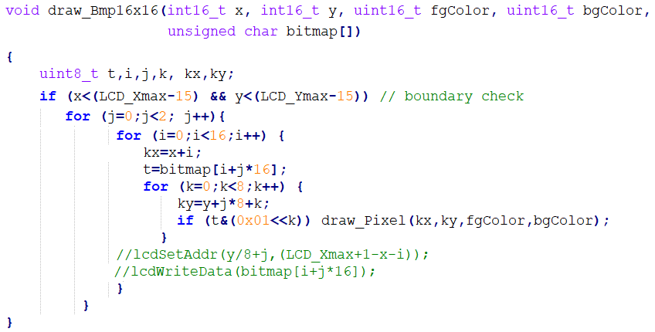
LCD.c
25

Slide 26
16x16 Bitmap Display
t
16 x 16
a byte data at t
(draw_Bmp16x16)
pixel at (kx,ky)
(draw_Pixel)
26

Slide 27
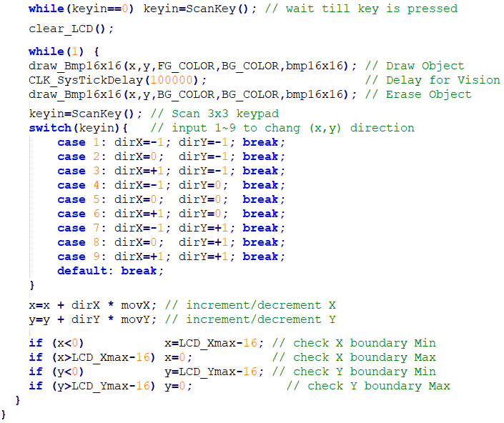
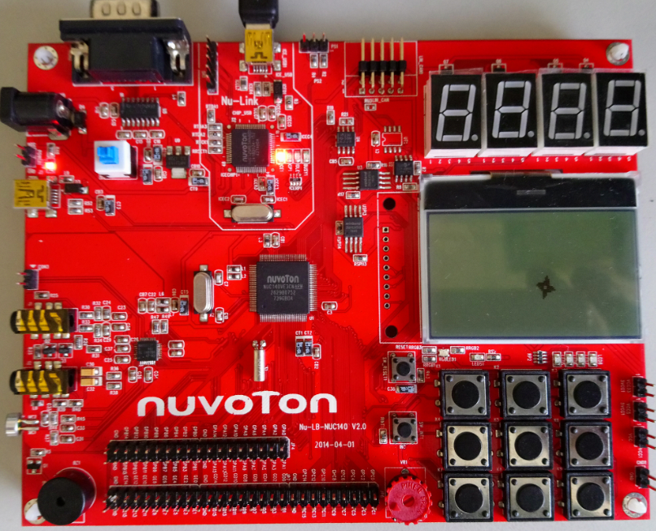
SampleCode: LCD_Bmp_Keypad (cont.)
1
2
3
4
5
6
7
8
9
27

Slide 28
Animation flow chart
Draw Object/Bitmap
on LCD Display
Delay for Vision
Erase Object/Bitmap
from LCD Display
Check Boundary
X, Y increment/decrement
28

Slide 29
Draw Objects
Draw a circle at x,y using foreground color
draw_Circle(x, y, r, fgColor, bgColor);
Or
draw_Bmp16x16(x, y, fgColor, bgColor, bitmap);
29

Slide 30
Display Objects
Delay for Vision (視覺暫留)
CLK_SysTickDelay(100000);
30

Slide 31
Erase Objects
Draw a circle at x,y using background color
draw_Circle(x, y, r, bgColor, bgColor);
Or
draw_Bmp16x16(x, y, bgColor, bgColor, bitmap);
31

Slide 32
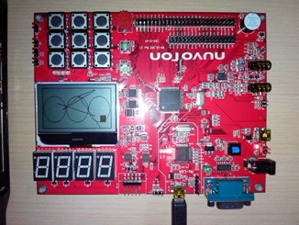
SampleCode: LCD_Graph_2D
Bresenham Line-Drawing Algorithm
Bresenham Circle-Drawing Algorithm
32

Slide 33
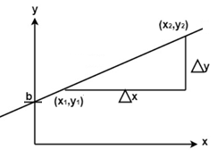
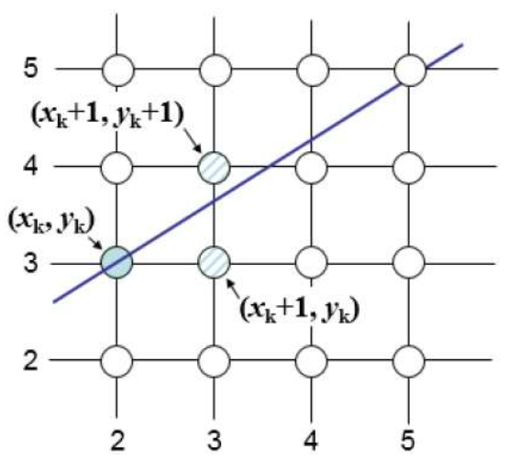
Bresenham Line-Drawing Algorithm
https://www.javatpoint.com/computer-graphics-bresenhams-line-algorithm
Line equation :
y=mx+b, where m =
The big advantage of this algorithm is that, it uses only integer calculations.
Moving across the x axis in unit intervals and at each step choose between two different points, that is (x_{k+1}, y_{k+1}) or (x_{k+1}, y_{k}).
33

Slide 34
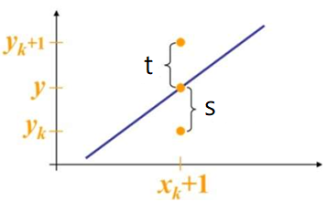
Bresenham Line-Drawing Algorithm
True line
The actual y coordinates of the line at x_{k+1}is y = mx_{k+1}+b = m(x_{k} + 1)+b
s = y-y_{k}
t = (y_{k}+1)-y
When (s-t) <0 ⟹ s < t, the closest pixel is y_{k}
When (s-t) ≥0 ⟹ s ≥ t, the closest pixel is y_{k}+1
This difference is s-t = (y-y_{k})-[(y_{k}+1)-y] = 2y - 2y_{k} -1 = 2m(x_{k} + 1) + 2b - 2y_{k} -1
Substituting m by
, and introducing decision variable d_{k}=△x (s-t)
d_{k}=△x ( 2 (x_{k}+1)+2b-2y_{k}-1)) =2△y∙x_{k} +2△y +△x∙2b - △x∙2y_{k} - △x
=2△y∙x_{k} - △x∙2y_{k} + c, where c=2△y+△x (2b-1)
34

Slide 35
Bresenham Line-Drawing Algorithm
We can write the decision variable d_{k+1} for the next slip on
d_{k+1}=2△y∙x_{k+1} - △x∙2y_{k+1} + c
d_{k+1}- d_{k} = 2△y(x_{k+1} - x_{k}) - 2△x(y_{k+1} - y_{k})
Since x_{k+1}= x_{k}+1, we have
d_{k+1}- d_{k} = 2△y(x_{k}+1 - x_{k}) - 2△x(y_{k+1} - y_{k}) = 2△y - 2△x(y_{k+1} - y_{k})
If chosen pixel is at y_{k}+1 (i.e., d_{k}≥0)⟹ y_{k+1}=y_{k}+1
d_{k+1} = d_{k} + 2△y - 2△x
If chosen pixel is at y_{k} (i.e., d_{k}<0)⟹ y_{k+1}=y_{k}
d_{k+1} = d_{k} + 2△y
Initial case:
= y₁
d₁ = △x[2m(x₁ + 1) + 2b - 2y₁ -1] = △x[2(mx₁+b-y₁)+2m-1] = △x[2m-1]
d₁ = 2△y -△x
Algorithm: read the draw_Line() code in Draw2D.c
35

Slide 36
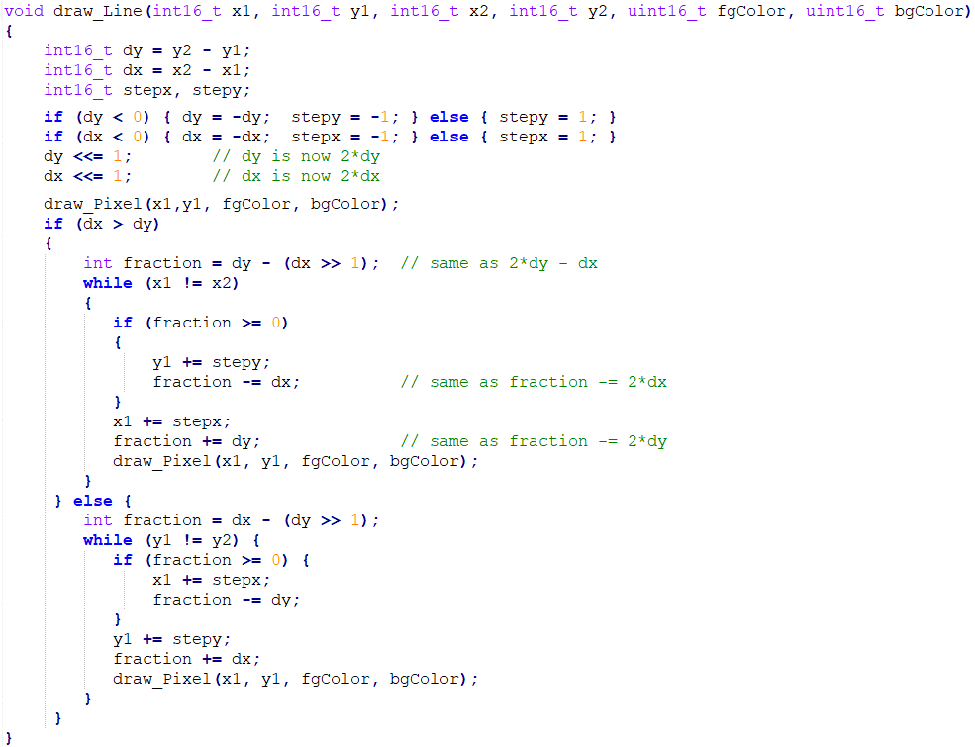
+
36

Slide 37
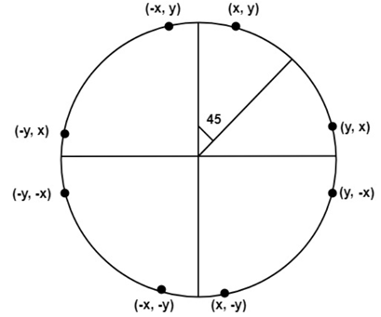
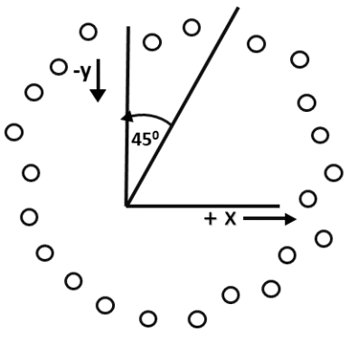
Bresenham Circle-Drawing Algorithm
https://www.javatpoint.com/computer-graphics-bresenhams-circle-algorithm
Scan-Converting a circle using Bresenham's algorithm works as follows:
Points are generated from 90° to 45°
Moves will be made only in the +x & -y directions
Then extends them to the other 7 octants, by using the concept of eight-way symmetry.
37

Slide 38
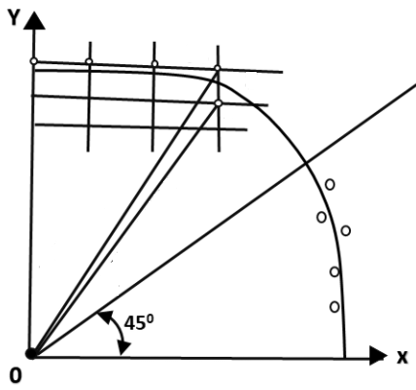
Bresenham Circle-Drawing Algorithm
Each new point closest to the true circle can be found by taking either of two actions.
Move in the x-direction one unit, point P =(x_{i}+1, y_{i})
Move in the x- direction one unit & move in the negative y-direction one unit, point Q =(x_{i}+1, y_{i}-1).
P
Q
D(t_{i}) is the distance to point P squared minus the distance from the origin to the true circle squared.
D(s_{i}) is the distance to point Q squared minus the distance from the origin to the true circle squared.
D(t_{i})=(x_{i}+1)²+ y_{i}² - r²
≧ 0
D(s_{i})=(x_{i}+1)²+ (y_{i}-1)² - r²
≦ 0
A decision variable
d_{i} =D(t_{i})+D(s_{i}) = (x_{i}+1)²+ y_{i}² - r² + (x_{i}+1)²+ (y_{i}-1)² - r²
If it is assumed that the circle is centered at the origin, then at the first step x = 0 & y = r.
d₁ = (0+1)²+ r² - r² + (0+1)²+ (r-1)² - r² = 3 – 2r
x_{i+1}=x_{i}+1
d_{i+1}=d_{i}+ 4x_{i}+6
Thereafter, if d_{i}<0, then only x is incremented.
if d_{i}≥0, then x & y are modified
x_{i+1}=x_{i}+1
y_{i+1}=y_{i}-1
d_{i+1}=d_{i}+ 4(x_{i}-y_{i})+10
38

Slide 39
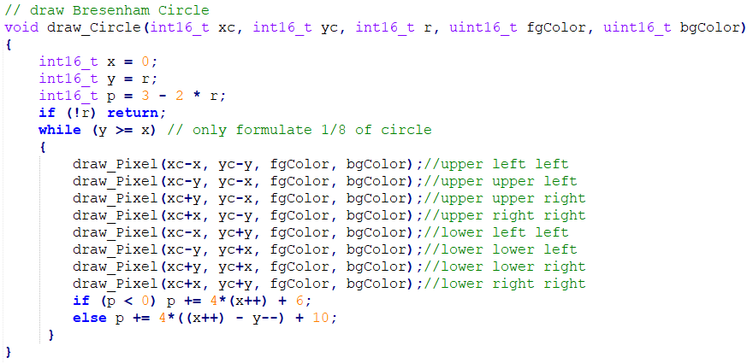
Draw2D.c
39

Slide 40
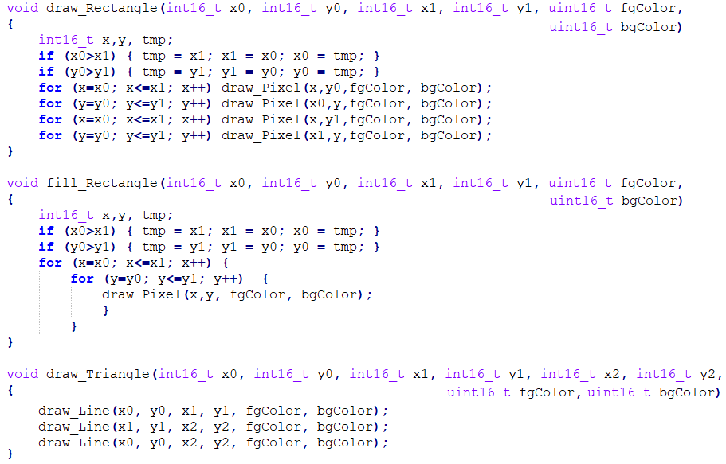
Draw2D.c
40

Slide 41
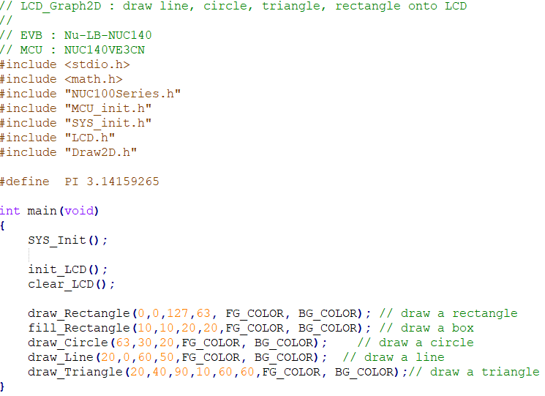
SampleCode: LCD_Graph_2D
41

Slide 42
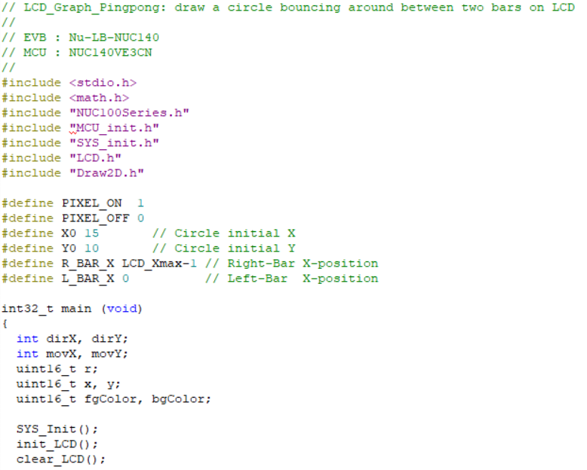
SampleCode: LCD_Graph_PingPong
42

Slide 43

SampleCode: LCD_Graph_PingPong
43

Slide 44

SampleCode: LCD_Graph_PingPong
44

